Slide 1
SFCS
SmartFan Control System
ECEN 5813 - EMBEDDED SYSTEM DESIGN
ISHA SHARMA

Slide 2
TABLE OF CONTENTS
SFCS, ISHA SHARMA, 12-03-2023
1
BLOCK DIAGRAM
HARDWARE
SOFTWARE
TIMELINE

Slide 3
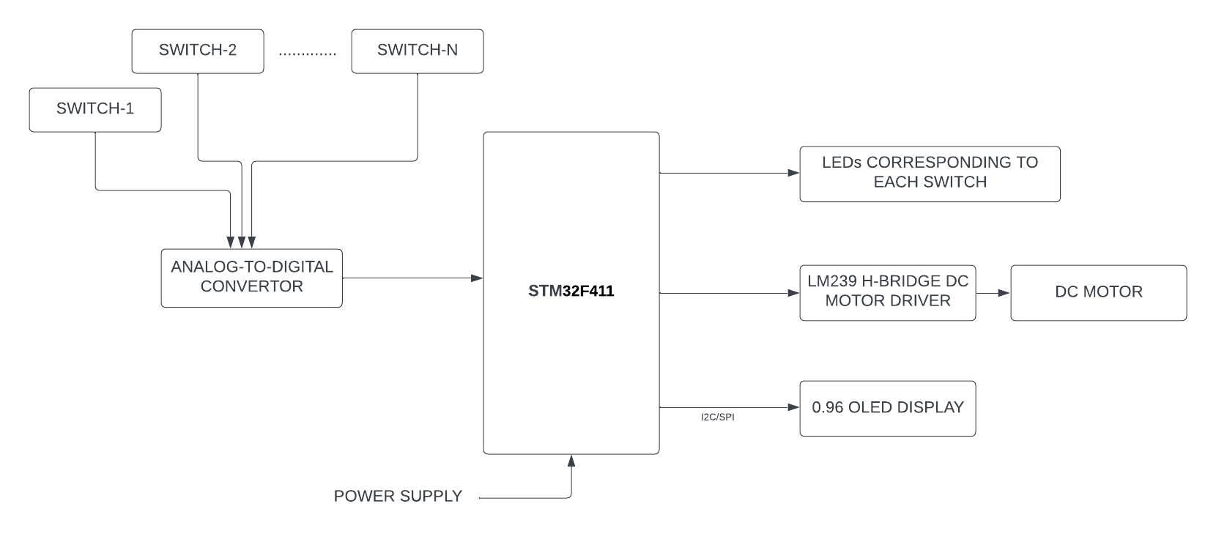
BLOCK DIAGRAM
SFCS, ISHA SHARMA, 12-03-2023
2

Slide 4
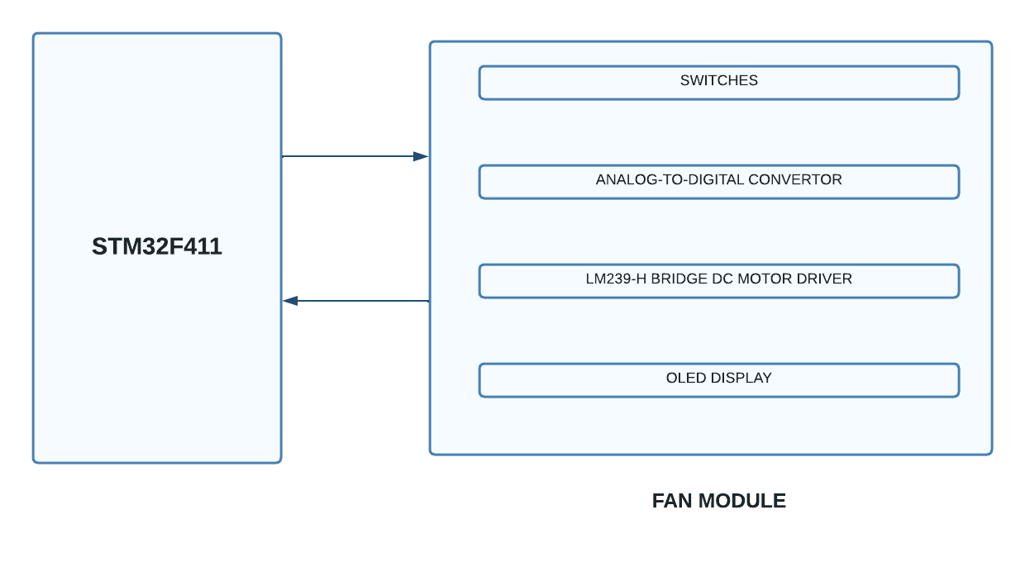
HARDWARE
SFCS, ISHA SHARMA, 12-03-2023
3

Slide 5
SOFTWARE
SFCS, ISHA SHARMA, 12-03-2023
4
BARE METAL PROGRAMMING FOR ALL COMPONENTS
SPI/I2C PROTOCOL FOR INTERFACING THE OLED
ADC
MOTOR DRIVER
LEDs
LOGIC ANALYSER

Slide 6
TIMELINE
SFCS, ISHA SHARMA, 12-03-2023
5
WEEK 9-10
WEEK 11
WEEK 12
WEEK 13-14
WEEK 15
WEEK 16
SCHEMATIC
LAYOUT
SENT FOR FABRICATION
CODING FOR SWITCH CIRCUITRY (SWITCH+ADC+LED)
GETTING PCB BACK
TESTING CODE ON PCB
CODING FOR OLED, MOTOR DRIVER
FINAL CODE TOUCHES
TESTING
DEBUGGING
FINAL DEMO
REPORT

Slide 7
THANK YOU!

